Slide 1







LIVING PLANTS
2022-1-BG01-KA220-SCH-000085065

Slide 2
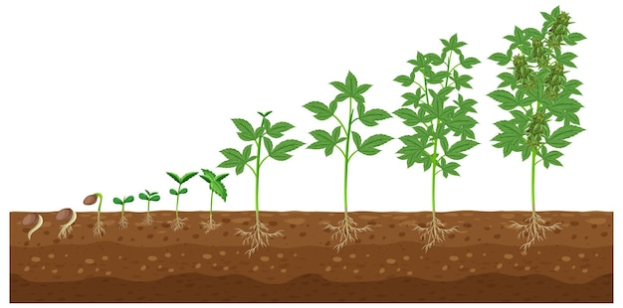

Plants
Plants are living beings; they are born, grow, reproduce and die.
In nature there is a great variety
of plants: some are big and tall like
trees, others are small and
and creeping.

Slide 3
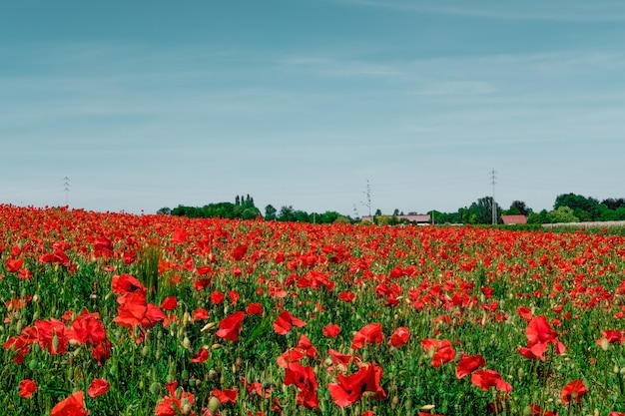
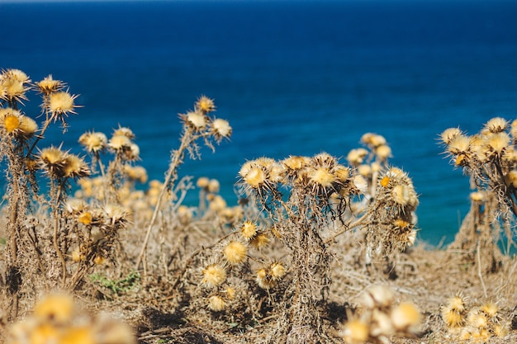
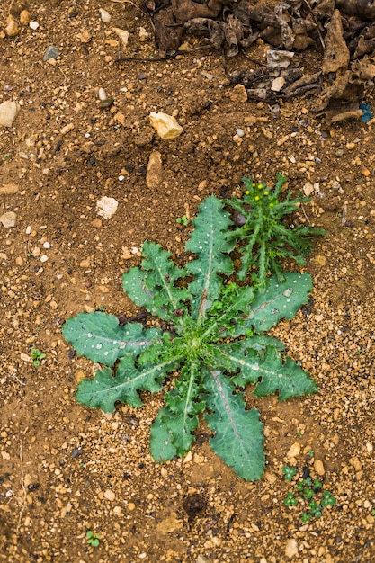
The way plants grow or appear in nature also varies, and they can be spontaneous plants or cultivated plants.
Spontaneous Plants
Spontaneous plants are plants that don't need to be cared for by humans. They appear and develop in nature spontaneously, they are not planted or sown.
The reproduction of these plants is due to the action of the wind, birds or other animals that spread the seeds.
Spontaneous plants grow in forests, fields, by the sea, etc.

Slide 4
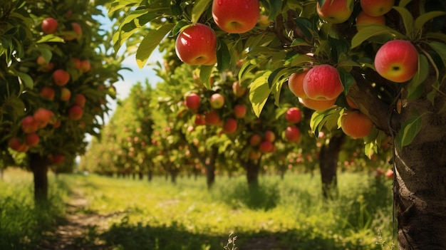
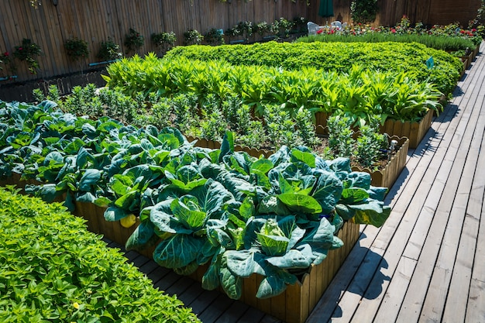
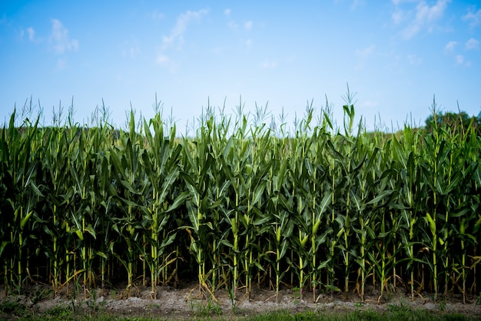
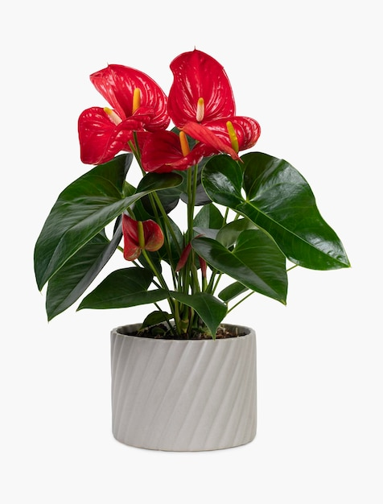
Cultivated Plants
Cultivated plants are those that need to be cared for by human beings. They appear and develop in nature as a result of human activity, are planted or sown and receive all the care they need to develop. Cultivated plants can be found in gardens, orchards, etc.

Slide 5
2022-1-BG01-KA220-SCH-000085065
Subject: Natural Science
Age of students: 7 – 8 years old
Topic: Nature
Resource Title: Living Plants
Credits: AECE – Escola Básica da Zona Verde
All media are within the EU intellectual property law.
The European Commission’s support for this publication does not constitute an endorsement of the contents, which reflect the views only of the authors, and the Commission cannot be held responsible for any use which may be made of the information contained herein.

